Slide 1
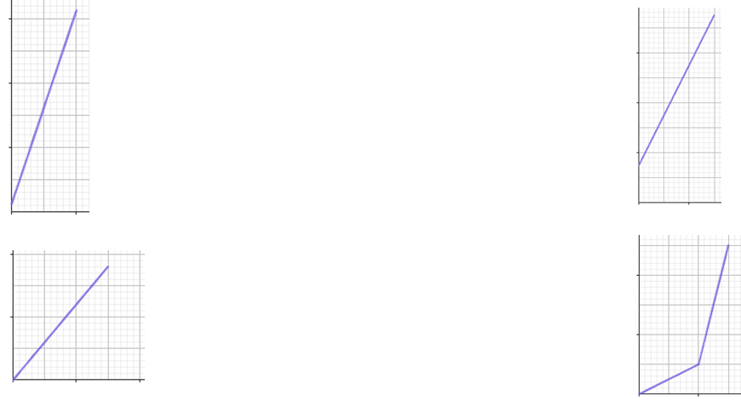
Graphing direct proportion
Task A: Features of graphs
1) Which of the following tables show that A and B are in direct proportion? Give a reason for your answers.
a) c)
b) d)
A | B
3 | 96
12 | 384
A | B
152 | 60.8
6 | 1.8
A | B
16 | 12
4 | 2.9
A | B
17 | 30.6
45 | 81
2) Which of the following graphs show two variables that are in direct proportion? Give a reason for your answers.
a) c)
b) d)

Slide 2
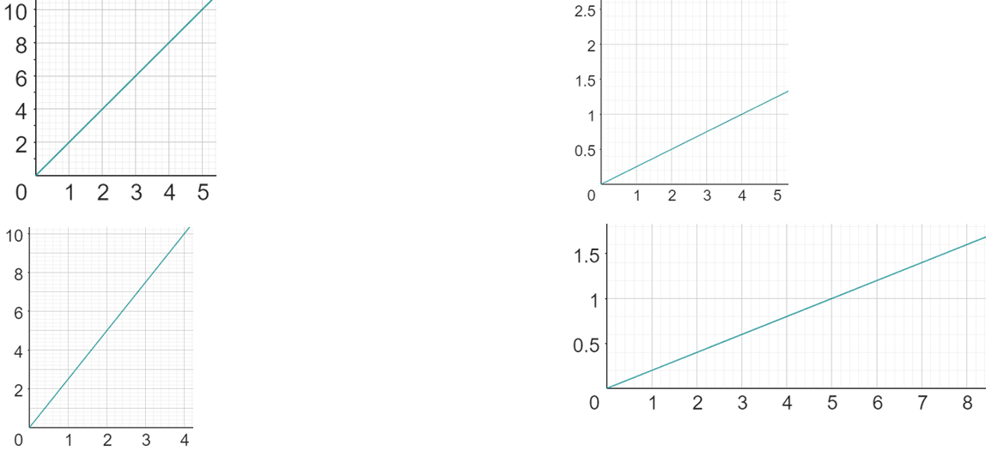
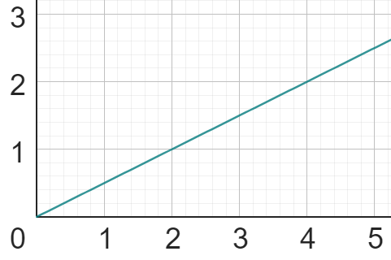
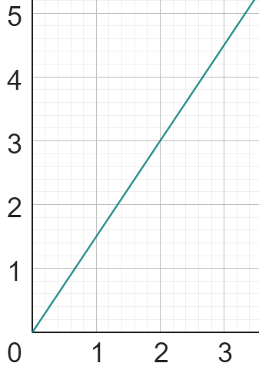
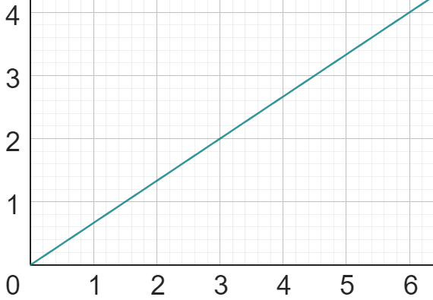
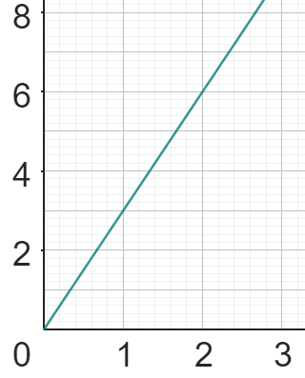
Graphing direct proportion
Task B: Graphs representing direct proportion
1) Calculate the value of k (constant of proportionality) from the following graphs:
a) c)
b) d)
y
y
k =
x
k =
x
y
y
k =
x
x
k =
2) Match each table, equation and graph.
a)
A
C
y = 3x
x | 0 | 2 | 4 | 6 | 8
y | 0 | 3 | 6 | 9 | 12
i)
ii)
y = 0.5x
b)
x | 0 | 1 | 4 | 7 | 10
y | 0 | 3 | 12 | 21 | 30
B
D
iii)
y = 1.5x
c)
x | 0 | 6 | 18 | 24 | 30
y | 0 | 4 | 12 | 16 | 20
iv)
y = x
d)
x | 0 | 2 | 8 | 12 | 18
y | 0 | 1 | 4 | 6 | 9
Mathematics in Education and Industry
v2.3

